Slide 1
Google Docs: Share & Access Settings
Google Docs Series
Presenter: Ashley Luna
Libr 257

Slide 2
Create, Share & Edit !

Slide 4
Objectives
In this session you will….
Recognize the steps needed to share documents
Identify Visibility/ Link Sharing modes
Identify appropriate access settings

Slide 5
Sharing
Three ways to share Google docs
Email
Link access
Combination of Both!

Slide 6
Where to start?

Slide 7
Link Access

Slide 8
Link Access

Slide 9
Email

Slide 10
Or Both!

Slide 11
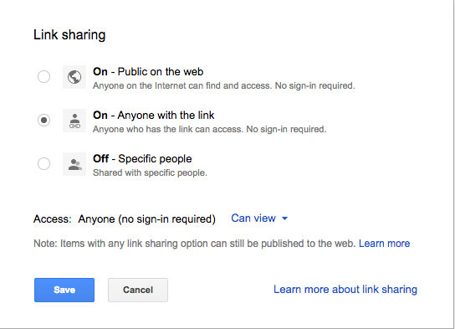
Visibility / Link Sharing Modes
A setting that allows the owner to set/change the visibility of documents.

Slide 12
Link Sharing

Slide 13
Advance

Slide 14
Advance…..

Slide 15
Which mode?

Slide 16
Access Settings
Control the way people access your documents
You can control who can …..
edit
comment
view

Slide 17
Access settings: Global
Control the way everyone accesses your document.
Control through link sharing
Link= same type of access
View, edit and comment

Slide 18
Global

Slide 19
Access settings: Individual
Control the way single users access your documents.
Control access through their email address
Edit, comment and view

Slide 20
Individual

Slide 21
Individual

Slide 22
Advance menu
Access to EVERYONE who can view and edit your document.
Control visibility
Control Global
Control individuals

Slide 23
Advance Menu

Slide 24
Advance menu

Slide 25
Access Settings
Edit Comment View

Slide 26
Recap!
To share documents you can:
Email invitations
Share links
Make them public

Slide 27
Recap…..
There are three visibility modes
Private (invitation only)
Anyone with link (anyone with link can access)
Public on the web (anyone can search and access your documents on the web)

Slide 28
Recap…..
Each visibility mode comes with Access settings
Edit
Comment only
View only

Slide 29
Recap
Each visibility mode allows you to set global and individual access settings.
Edit
Comment only
View only

Slide 30
Objectives
In this session we ….
Recognized the steps needed to share documents
Identified Visibility/ Link modes
Identified appropriate access settings

Slide 31
Questions, Comments?
Email me!
ashley.luna@sjsu.edu
Please be on the look out for more upcoming sessions with Google Docs!

