Slide 1
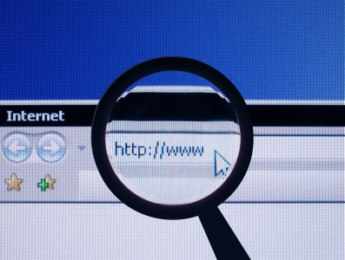
High School Seniors Evaluating Websites for Research on the United States Legislative Branch
Students Becoming Better Searchers Through CARS and Well
Informed on the Legislative Branch

Slide 2

Introduction
Using websites as sources for your research papers -- How do you choose which ones are useful and which are not?
Notes:
Teachers: the objective here is to provide high school seniors in your civics classes who are researching and writing papers on the legislative process in the federal government, with the means to identify, navigate, compare and choose high quality online information sites to accomplish those tasks, by applying the CARS method of assessing internet sources. The skills students acquire from this presentation will better equip them to deal with the rigors of performing at the college level, when invariable they will be faced with a crush of information - much of it of dubious value, and for any number of reasons. Learning CARS gives students tangible guidelines for judging how well a site will meet their information needs. That way, when confronted with many sources that discuss a topic, students can use CARS to locate the best available ones, and discard the rest.
Students: As seniors, you will be writing research papers for your civics classes on the legislative branch of government. While searching for information for your papers, you will uncover many websites containing information on this topic. Much of it will be of little or no value to you in this project. However, some of the information you may find useful. But a word of caution -- you will do well to consider the source. It is important that as you get ready to embark on your college careers, you begin to understand how to distinguish between good and bad websites. This presentation will help you learn to tell the difference.

Slide 3

CARS Method
A set of criteria that will help you evaluate whether or not a website is fit to be used in your research papers.
Notes:
Then, when searching online, you will be able to identify the authoritative and reliable sources, compare them with others out there, and choose the highest calibre online information, through use of the CARS method for evaluating internet sites.. CARS offers you tangible guidelines for judging how well a site will meet your information needs. There will be many websites that discuss the same topic. If you learn to apply CARS principles to figure out which sources offer the best quality information, you can discard the rest.

Slide 4

CARS Method for evaluating websites
Credibility
Accuracy
Reasonableness
Support
Notes:
C is for credibility, A is for accuracy, R is for reasonableness, and S is for support. We will talk more about each of these in the following slides.

Slide 5

Credibility
Indicators to Credibility:
Does the site include the author’s credentials?
Can the author/organization be contacted?
Does the information come from a credible source?
Notes:
Evaluating credibility is the first thing you should do when evaluating a website. Look at the url itself. Is the domain a .gov or .edu? Is there clearly posted contact information?

Slide 6

Accuracy
Indicators of a Lack of Accuracy:
Does the page you are looking at have a date that tells you when it was published or updated?
Does it use words that are passive rather than direct?
Is the information outdated?
Notes:
Next is accuracy. You want to make sure that the website you are on has posted factual and unbiased information. Also you want to make sure that the information presented is current and updated.

Slide 7

Reasonableness
Indicators of a Lack of Reasonableness:
Intemperate tone or language (“stupid jerks,” “shrill cries of my extremist opponents”)
Overclaims (“Thousands of children are murdered every day in the United States.”)
Notes:
Next is R for Reasonableness. You want to make sure that what you are reading is coming from a reliable source that is aimed toward education rather than for propaganda or financial purposes. You want to make sure that information that is presented is in a professional tone, not a casual or informal tone. This part is related to accuracy.

Slide 8
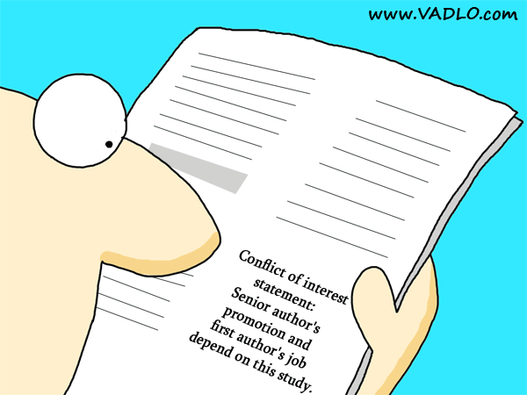
Reasonableness (continued)
Sweeping statements of excessive significance (“This is the most important idea ever conceived!”)
Conflict of interest (“Welcome to the Old Stogie Tobacco Company Home Page. To read our report, ‘Cigarettes Make You Live Longer,’ click here.” or “When you buy a stereo, beware of other brands that lack our patented circuitry.”)
Notes:
If the site seems like its main purpose is to sell a product or service, it is not fit for using in your research.

Slide 9

Support
Indicators of a Lack of Support:
Numbers or statistics presented without an identified source for them
Absence of source documentation when the discussion clearly needs such documentation
Lack of any other sources that present the same information or acknowledge that the same information exists (lack of corroboration)

Slide 10
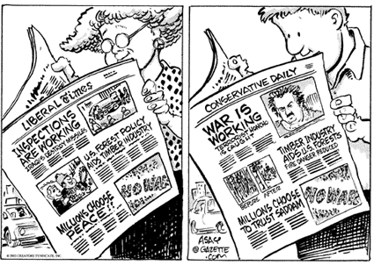
Looking for Bias or Point of View
Look for “Who” is writing the source, and “what” their point of view is.
Use these definitions when thinking about point of view or bias:
Notes:
When evaluating information found on the Internet, it is important to examine who is providing the "information" you are viewing, and what might be their point of view or bias. Use these definitions when you are unsure about a resource.

Slide 11

Information
"Knowledge communicated concerning some particular fact, subject, or event; that of which one is apprised or told; intelligence, news. spec. contrasted with data." (from Oxford English Dictionary, 2nd ed., 1989)

Slide 12
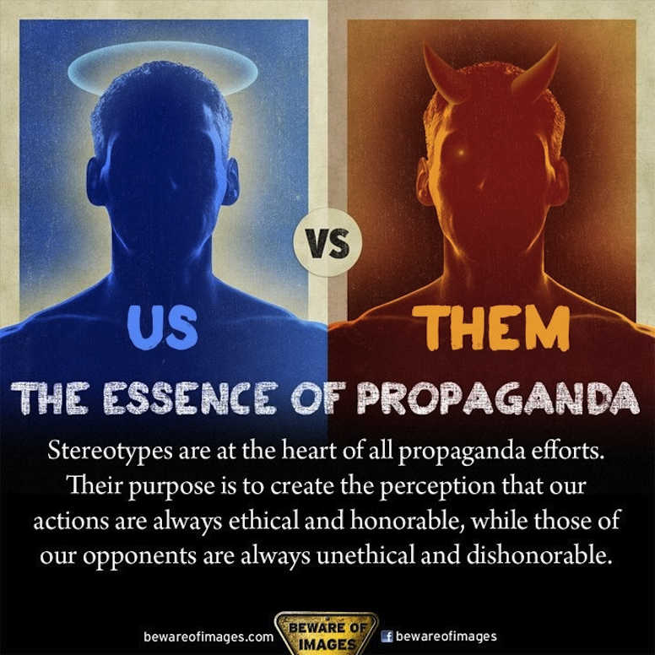
Propaganda
"The systematic propagation of information or ideas by an interested party, esp. in a tendentious way in order to encourage or instill a particular attitude or response. Also, the ideas, doctrines, etc., disseminated thus; the vehicle of such propagation.”(from Oxford English Dictionary, 2nd ed., 1989)

Slide 13

Disinformation
"The dissemination of deliberately false information, esp. when supplied by a government or its agent to a foreign power or to the media, with the intention of influencing the policies or opinions of those who receive it; false information so supplied." (from Oxford English Dictionary, 2nd ed., 1989)

Slide 14

Questions to Consider:
Train your mind!!
Questions to consider:
1. What can the URL tell you?
2. Is it somebody’s personal page?
3. What type of domain does it come from?
(educational, nonprofit, commercial, government, etc.)
4. Who wrote the page?
5. Is the page dated? Is it current enough?

Slide 15

Questions to Consider:
6. What are the author’s credentials on this subject?
7. Are there links to other resources on the topic?
8. Why was the page put on the web?
9. Is this as credible and useful as the resources (books, journal articles, etc.) available in print or online through the library?

Slide 16
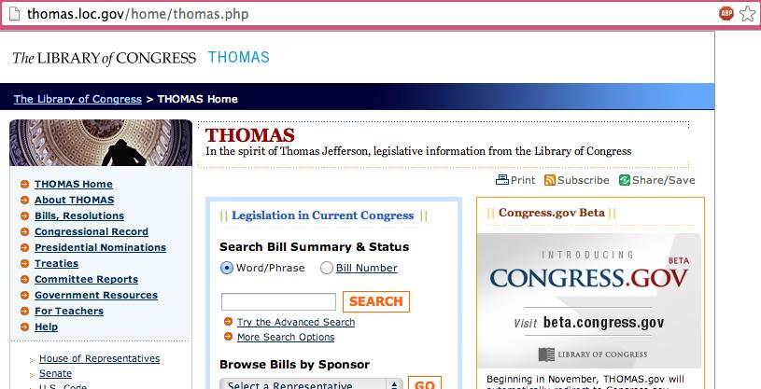
Good Website #1: Thomas.gov
Notes:
Now you can see some examples. This is Thomas. Lets go through CARS and evaluate this site.
C is for credibility. It is a website put out by the Federal Government.
A is for accuracy. The information on the site is current, complete and correct
R is for reasonableness. The information doesn’t show a bias
S is for sources. The information contained in the site connects to actual texts of bills

Slide 17
Good Website # 1 Thomas
Government site
.gov
Current complete and correct
Unbiased
Connects to actual texts of bills

Slide 18
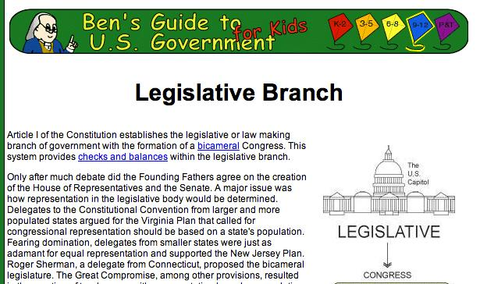
Good Website #2
Ben's Guide to U.S Goverment for Kids
Notes:
This is Ben’s Guide to the US Government for Kids. This site doesn’t look as professional as the last one. Does that mean it is not as reliable? Lets find out
C is for credibility. It is a website put out by the Government Printing Office
A is for accuracy. The information on the site is simplified, but correct
R is for reasonableness. Unbiased, “just the facts” format
S is for sources. The information from GPO

Slide 19
Good Website #2
Ben's Guide to U.S Goverment for Kids
Service of the Government Printing Office
Simplified, but accurate

Slide 20
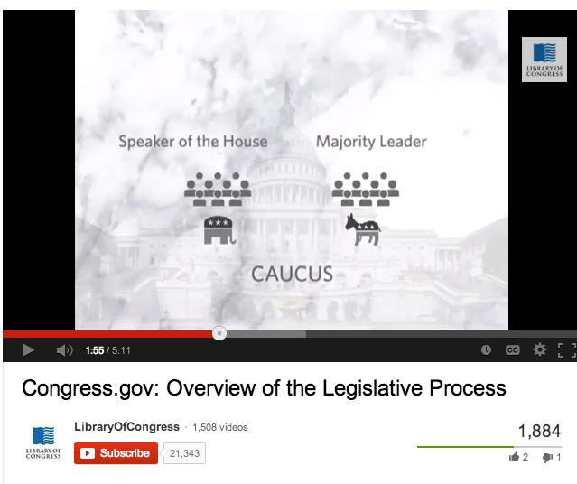
Good Website #3
Library of Congress Youtube Videos
Notes:
(Note: On this slide, the presenter would show this youtube clip, then resume the presentation)
Not all sources need to be strictly websites. This is a list of YouTube videos. But anyone can post item to YouTube. How good is this source?
C is for credibility. Videos uploaded by Library of Congress
A is for accuracy. Huge amounts of correct information
R is for reasonableness. Unbiased
S is for sources. The information supplied by LoC

Slide 21
Good Website #3
Library of Congress Youtube Videos
Reliable source
Educational
Unbiased

Slide 22
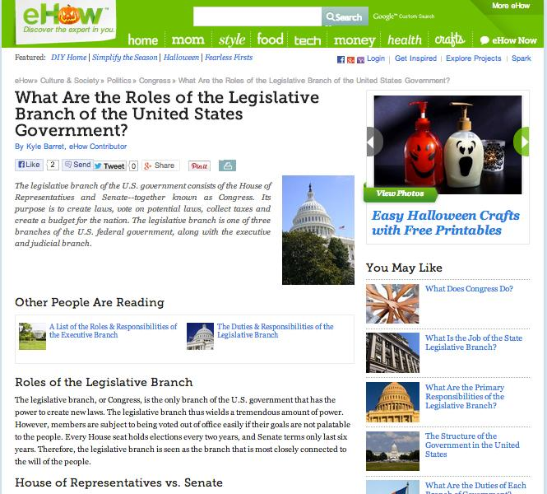
Bad Website #1 eHow
Notes:
Ehow is a “content farm” in which freelancers write articles in mostly “how” to do things. Ehow mainly wants to produce maximum search results from search engines. This website does not meet any of the CARS method criteria, so it is suitable to be a bad website. There are a lot of advertisements on this commercial website. The entire webpage for the legislative branch is of low quality, mediocre and inferior information presented. Very vague and the information does not go much into detail about the legislative branch.

Slide 23
Bad Website #1 eHow
Does not meet any of CARS criteria
Too many advertisements, commercial website
Very vague, lacks detailed information

Slide 24
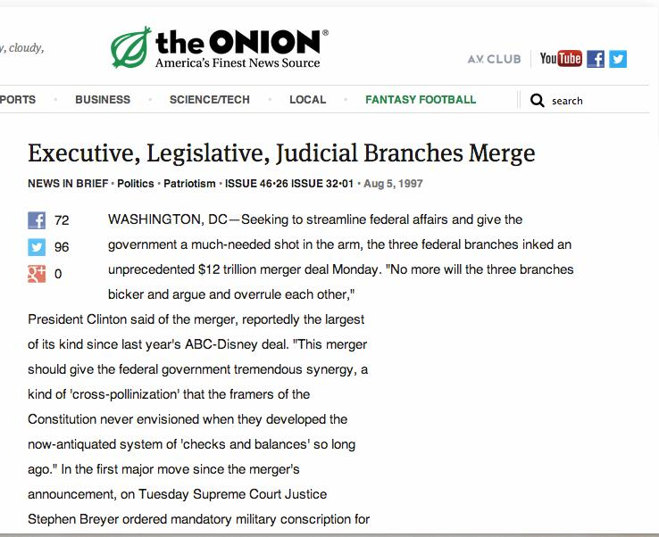
Bad Website #2 The Onion
Notes:
The Onion is a satirical entertainment commercial website with many advertisements. The article “Executive, Legislative, Judicial Branches Merge” is meant to be funny, not be taken seriously making fun of the three government branches. It is not a “real” article to be taken seriously, rather one that mimics such shows like The Daily Show and The Colbert Report. This website is not reasonable, accurate, credible or supported and was last updated August of 1997, so it is outdated.

Slide 25
Bad Website #2 The Onion
Commercial website
Not credible, accurate, reasonable, or supported
It was last updated August 1997

Slide 26
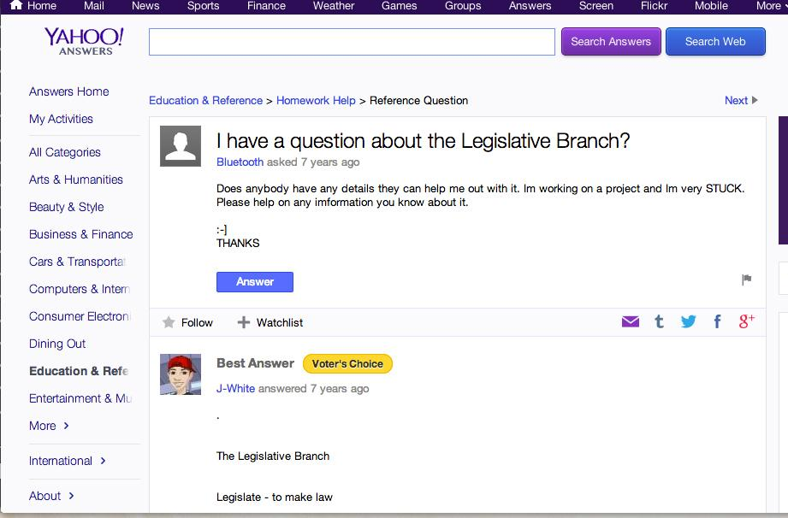
Bad Website #3 Yahoo Answers
Notes:
Yahoo Answers can be answered by anyone and it is a commercial website with many ads.
It is not a credible website due to lack of any researchers, professors, or experts answering people’s questions.
No difference or system between correct or incorrect answer. Anyone Yahoo user can answer or ask a question and receive points, while the best answer is the one that is voted the highest, so the answer may not be 100% accurate.

Slide 27
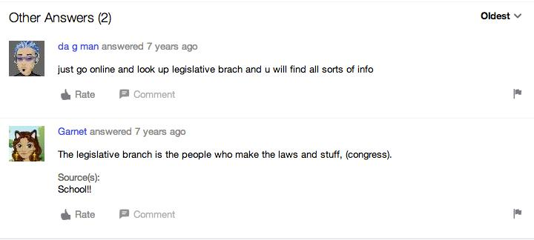
Bad Website #3 Yahoo Answers
Notes:
Yahoo Answers can be answered by anyone and it is a commercial website with many ads.
It is not a credible website due to lack of any researchers, professors, or experts answering people’s questions.
No difference or system between correct or incorrect answer. Anyone Yahoo user can answer or ask a question and receive points, while the best answer is the one that is voted the highest, so the answer may not be 100% accurate.

Slide 28
Bad Website #3 Yahoo Answers
Not trustworthy; commercial website
Not credible due to lack of researchers, professors, or experts

Slide 29
Your Turn!!!
Your task:
Find a website on the legislative branch (Congress, bills, legislators)
Evaluate it using the C.A.R.S. method
Share your website with the class
Explain your evaluation of the website to the class
Complete the worksheet
Notes:
Now that we have learned about the C.A.R.S. method it is time for you to do it. You need to break into groups of two or three students. No groups may have more than three students. Your task is to: First, find a website on the legislative branch, it can be good or bad. Some key words to help you search are congress, bills, legislators, republicans, democrats. You get to choose how you search. Second, evaluate the website using the C.A.R.S. method. I will hand out a worksheet to help you, but you have to do the evaluation. Third, you will share your website and evaluation with the class. This is your way to help each other find sources for you teacher’s assignment. Finally, you must fill out the worksheet and return it to me. This is important as I want to know what you learned.

Slide 30
Conclusion
First, we introduced the CARS checklist for evaluating websites.
Then support, looking for bias or points of view was introduced.
Good and bad examples of websites were shown.
Students given the opportunity to find a legislative website, evaluate it using CARS method, then share it, explain evaluation to the class, and complete the worksheet.
Notes:
And that brings us to the end of the presentation. Let me give a summary of what has been talked about from these past several minutes.
First, our presentation introduced the importance of the CARS checklist for evaluating websites. C stands for credibility, A for Accuracy, R for reasonableness, and S for support. Then after the CARS method, support was mentioned as well as looking for bias or points of view were discussed. Afterwards, the three examples of each good websites and bad websites of the legislative branch were shown. Finally, students had the opportunity to look for a legislative website, then evaluate it using the CARS method, then share it with their fellow classmates while explaining their evaluation and complete the worksheet as a part of the assignment. As a result from this legislative project, these high school seniors will become familiar and knowledgeable about the legislative branch. The students will realize research takes skill, time, and pertinence when using the CARS method. The various levels in completing research through several types of sources and formats that will allow the students to become more comfortable, poised, and improved in performing research and assignments in the future. This concludes the presentation.

Slide 31
References
Barret, K. (n. d.). What Are the roles of the legislative branch of the United States government? eHow.com. Retrieved October 19, 2013, from http://www.ehow.com/list_6908069_roles-branch-united-states-government_.html
Berkowitz, R.E. (2010). Big 6 Instructional unit design template. Retrieved October 5, 2013 from http://big6.com/media/freestuff/Berkowitz2.Unit_design_template.pdf
Bluetooth, (Yahoo! username). (2006). I have a question about the Legislative Branch? answers.yahoo.com. Retrieved October 19, 2013, from http://answers.yahoo.com/question/index?qid=20070509153208AAmd9Cd
Library of Congress (2013, April 30).Congress.gov: Overview of the legislative process. YouTube.com. Retrieved October 19, 2013, from http://www.youtube.com/watch?v=E1CIWwu6KdQ
Library of Congress (n.d.). Thomas. thomas.loc.gov. Retrieved October 19, 2013, from http://thomas.loc.gov/home/thomas.php
McGraw-Hill Higher Education. (2003). The CARS checklist (Credibility, accuracy, reasonableness, support). highered.mcgraw-hill.com. Retrieved October 19, 2013, from http://highered.mcgraw-hill.com/sites/0079876543/student_view0/research_center-999/research_papers30/conducting_web-based_research.html

Slide 32
References
The Onion (1997, August 5). Executive, legislative, judicial branches merge. The Onion. Retrieved October 19, 2013, from http://www.theonion.com/articles/executive-legislative-judicial-branches-merge,4476/
Oxford English Dictionary. (1989). (2nd ed.). Oxford: Clarendon.
The Regents of the University of California. (2012). Evaluating web pages: Techniques to apply & questions to ask. lib.berkeley.edu. Retrieved October 19, 2013, from http://www.lib.berkeley.edu/TeachingLib/Guides/Internet/Evaluate.html
Sheridan Libraries. (2010). Evaluating information found on the internet. guides.library.jhu.edu. Retrieved October 19, 2013, from http://guides.library.jhu.edu/evaluatinginformation
Superintendent of Documents, Government Printing Office (2007, February 7). Ben’s guide to U.S. government for kids. bensguide.gpo.gov. Retrieved October 19, 2013, from http://bensguide.gpo.gov/9-12/government/national/legislative.html

Slide 33
Thank you!

